Slide 1


Time Series analysis on precipitation of philadelphia
Cory Boyko

Slide 2
Introduction
Weather affects our everyday lives, but how predictable is it?
Precipitation is believed to change with time
Occurs periodically EX it can’t rain/snow forever and it can’t be a drought forever

Slide 3
motivation
Philadelphia was chosen because it has ‘natural’ seasons in terms of temperature
Precipitation will possibly have cycles as well
5 time series were initially investigated and models were made for four of them: daily, weekly, monthly, seasonally, and yearly (with the latter four being modeled)

Slide 4
hypothesis
The shorter time series will be more difficult to model due to variation
The longer time lengths will have better models, but are less useful
AR models will be the best

Slide 5
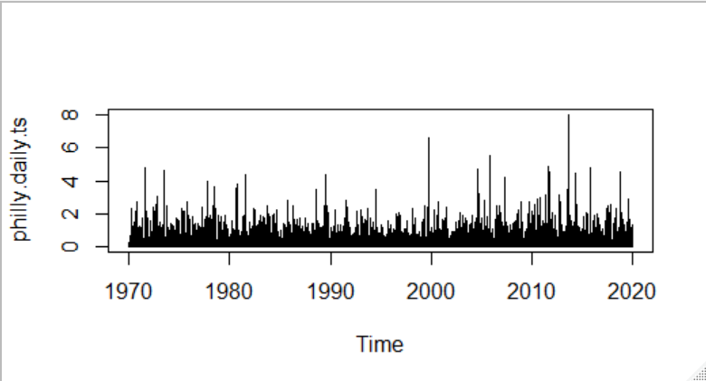
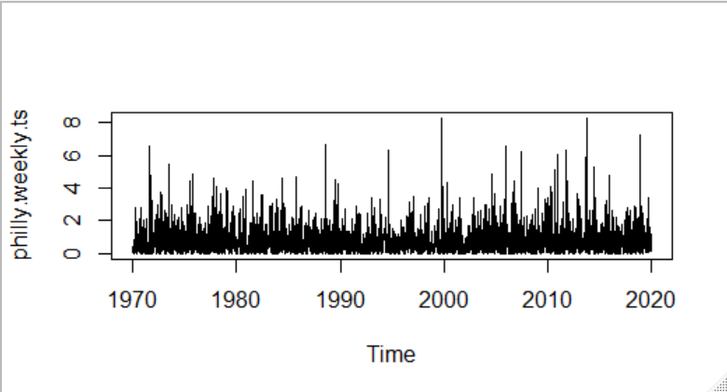
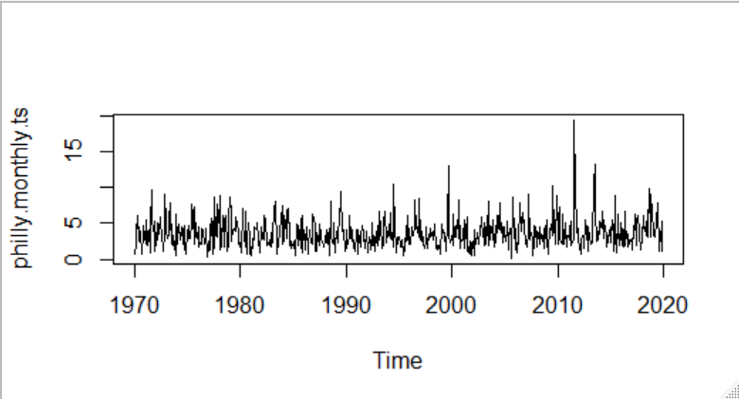
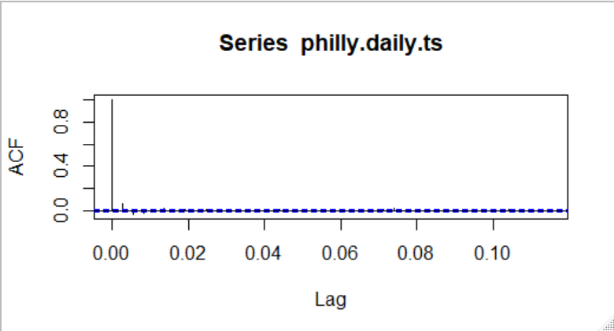
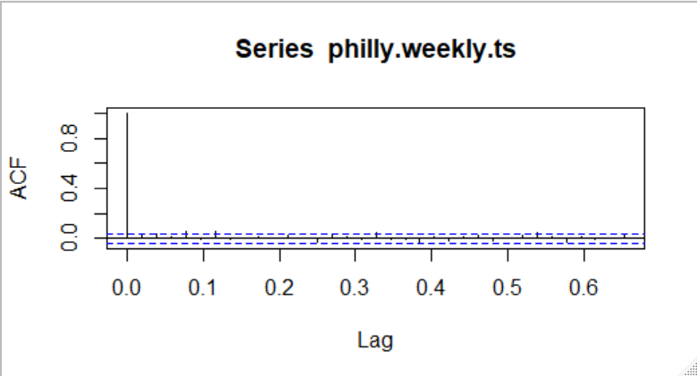
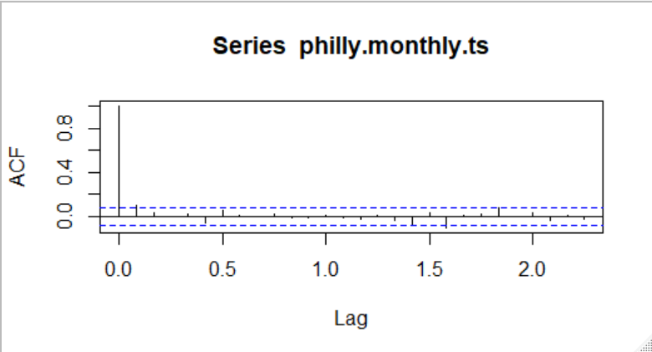
Basic plots – daily, weekly, and monthly

Slide 6
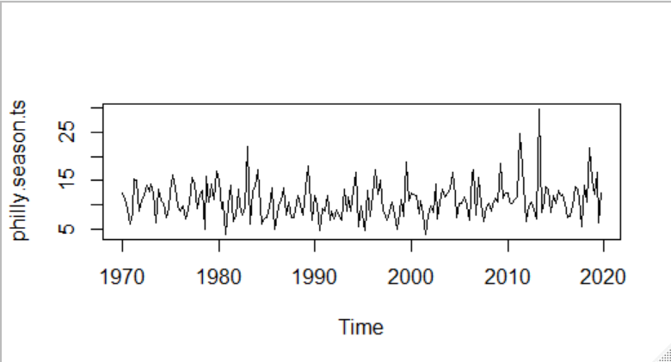
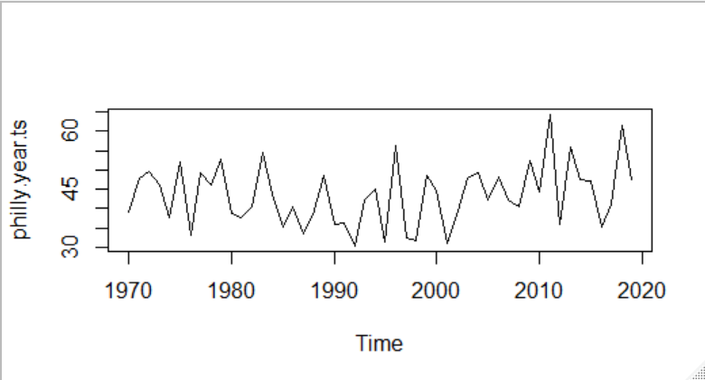
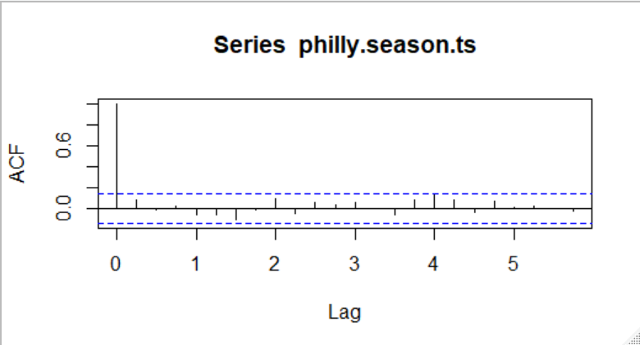
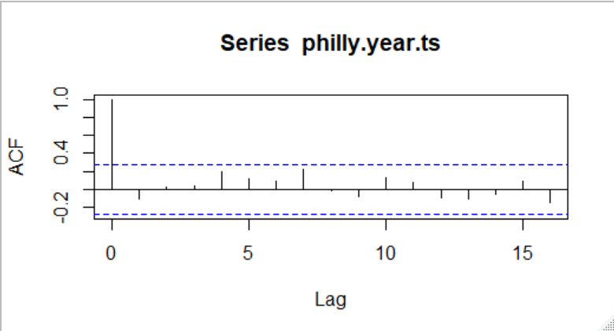
Basic plots – seasonal and yearly

Slide 7
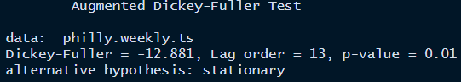
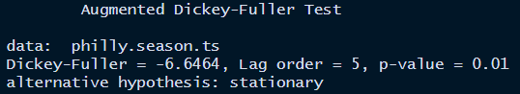
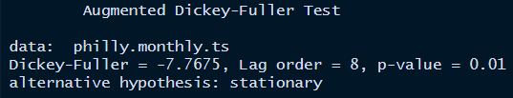
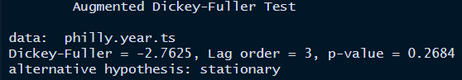
Augmented dickey fuller tests

Slide 8
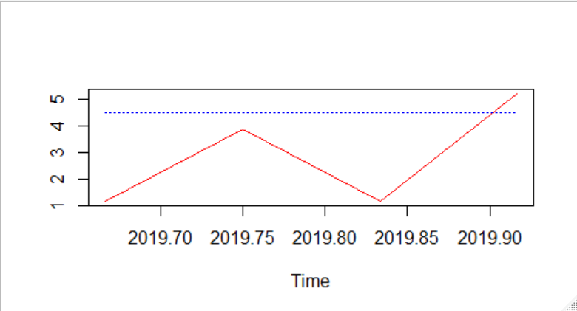
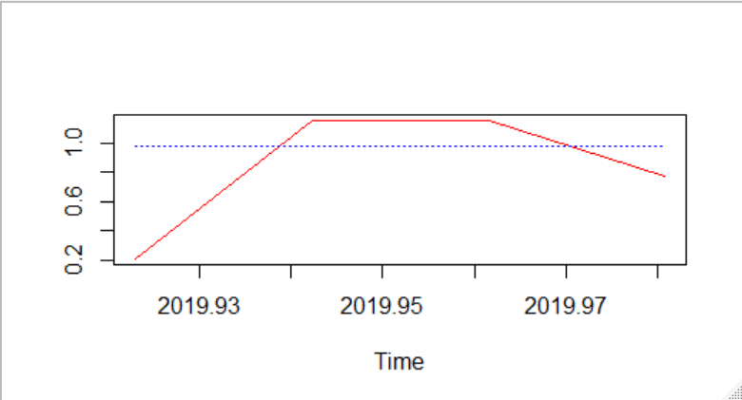
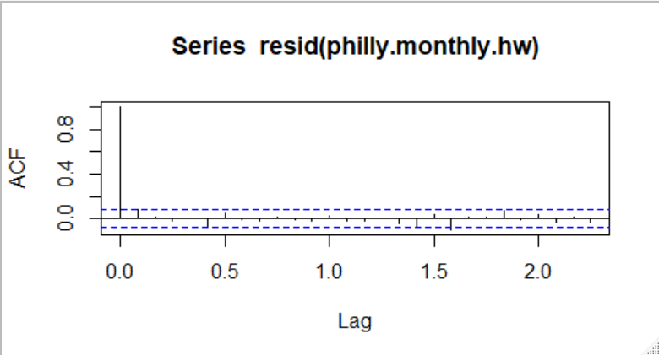
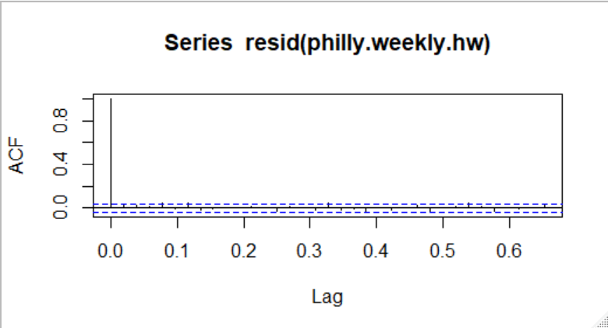
Holt Winters: Weekly & Monthly
Weekly alpha: 0.013
Monthly alpha: 0.0655
Weekly MAPE: 105.28
Monthly MAPE: 152.41

Slide 9
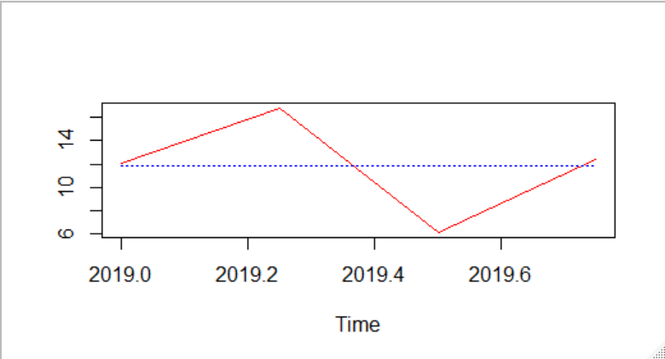
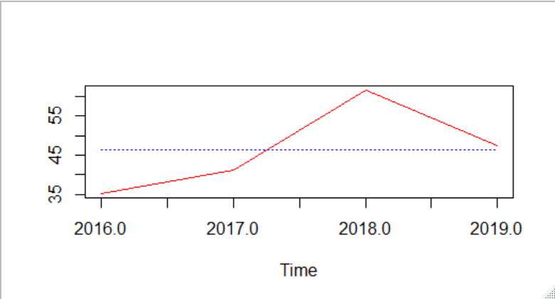
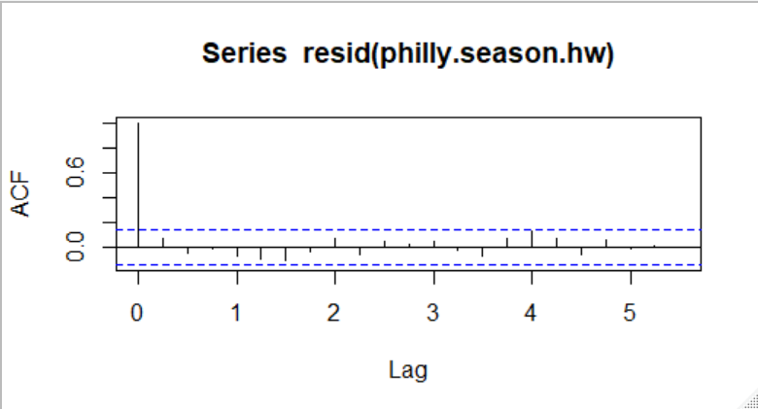
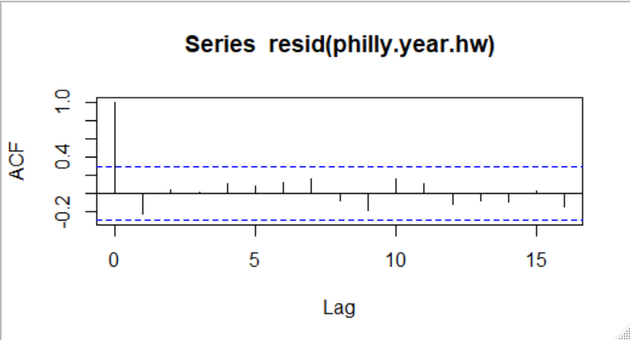
Holt Winters: Seasonal and yearly
Seasonal alpha: 0.0409
Yearly alpha: 0.1197
Seasonal MAPE: 31.85
Yearly MAPE: 17.60

Slide 10
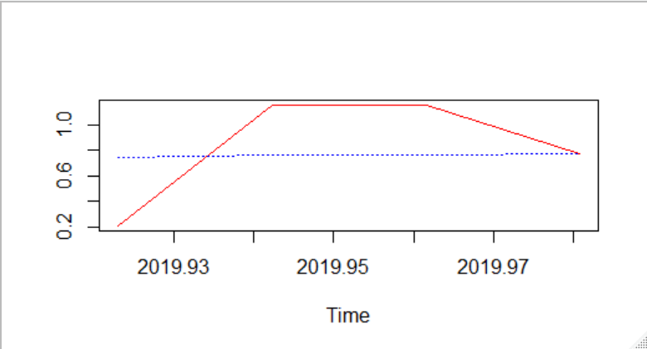
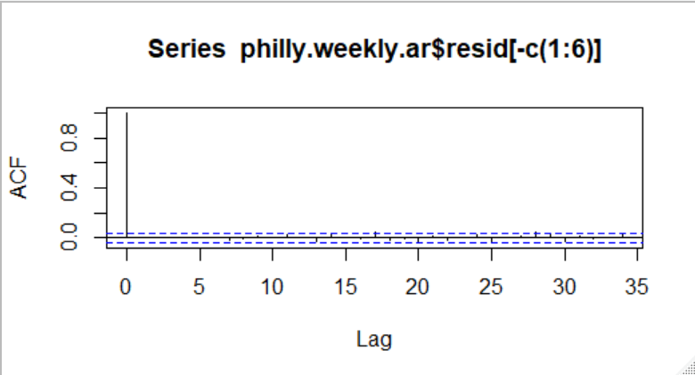
AR: Weekly
Table 3. Weekly AR(6) Coefficients
AR | 2.50% | 97.50%
1 | -0.0165 | 0.062
2 | -0.0129 | 0.0657
3 | -0.0248 | 0.0536
4 | 0.0085 | 0.0869
5 | -0.0511 | 0.0275
6 | 0.0113 | 0.0898
Best Model: AR(6)
Only 4 and 6 are significant (both positive)
MAPE: 79.74

Slide 11
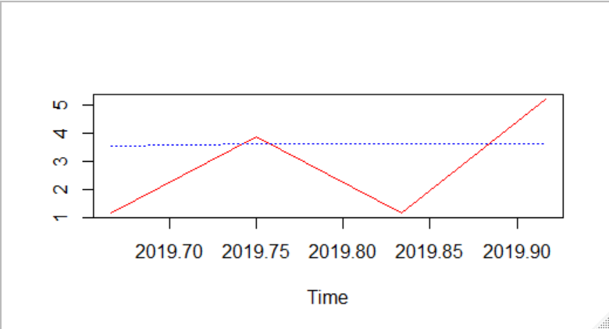
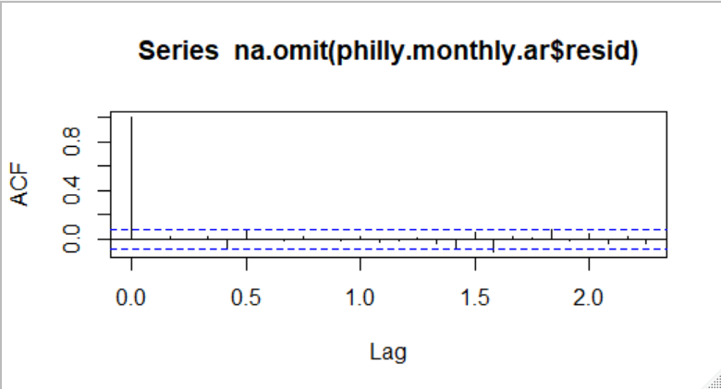
AR: Monthly
Table 4. Monthly AR(1) Coefficient
AR | 2.5 | 97.5
1 | 0.022 | 0.185
Best model: AR(1)
The coefficient is significant (positive)
MAPE: 113.67

Slide 12
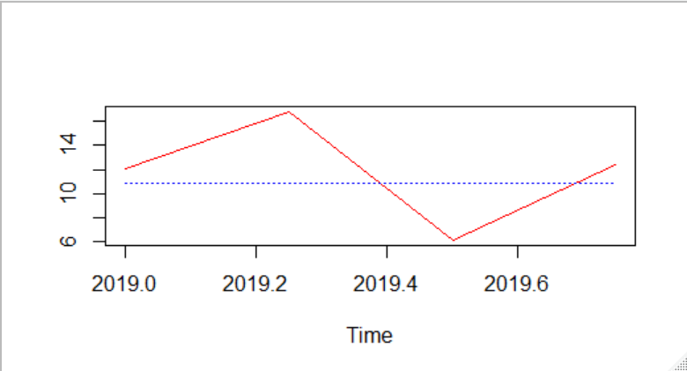
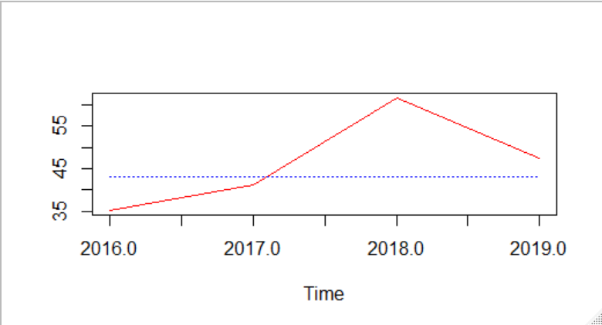
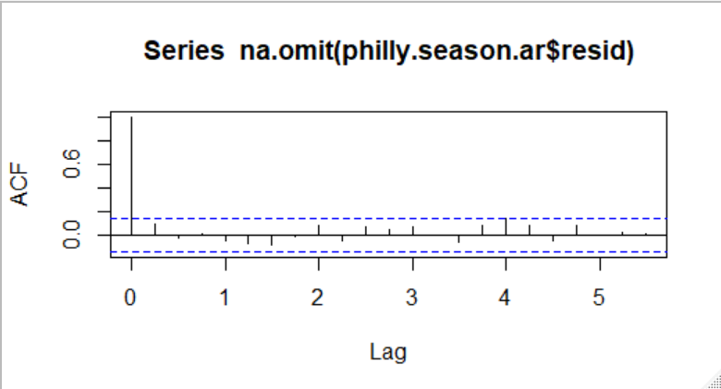
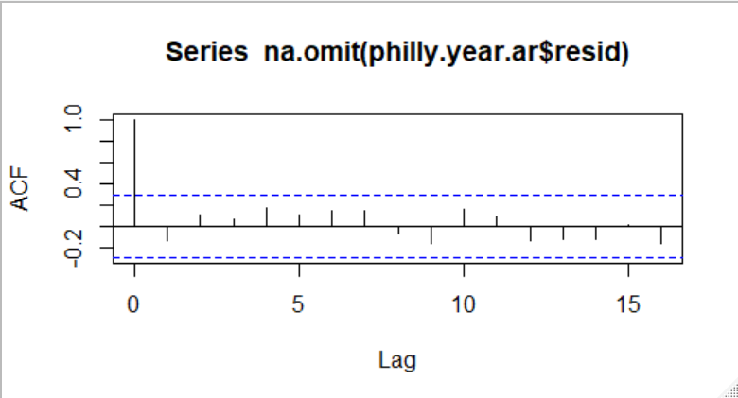
AR: Seasonal and yearly
Best model for both: AR(0)
Seasonal MAPE: 33.32
Yearly MAPE: 16.39

Slide 13
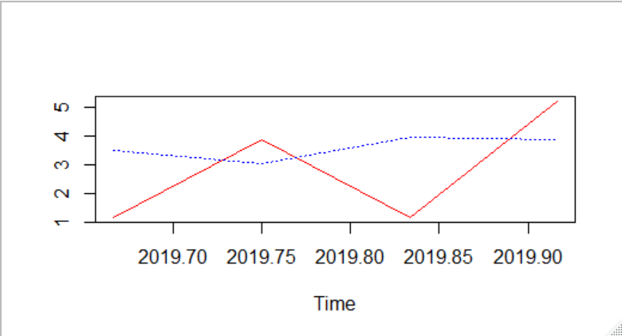
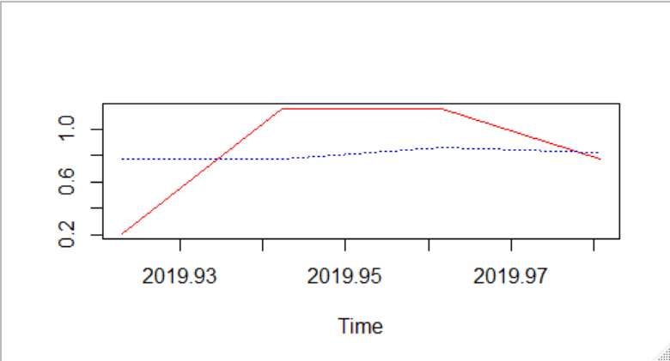
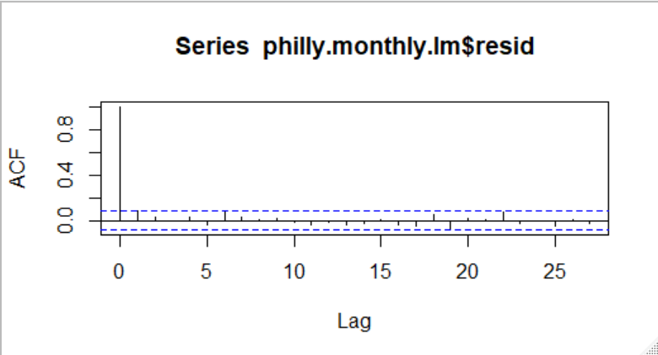
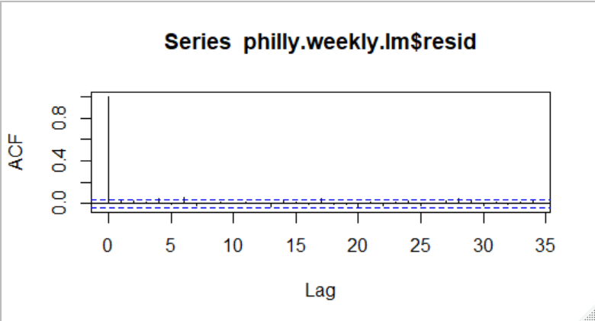
Linear regression: weekly and monthly
Weekly had no significant coefficients
Monthly had no significant coefficients
Weekly MAPE: 82.84
Monthly MAPE: 122.77

Slide 14


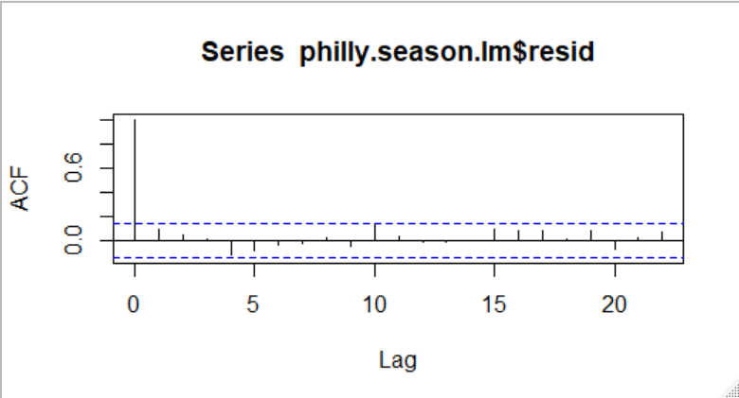
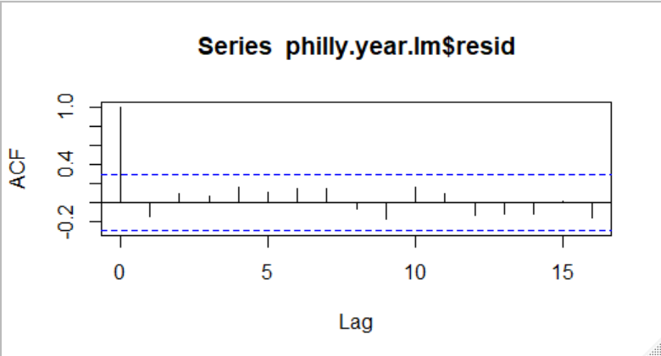
Linear regression: seasonal and yearly
Seasonal had no significant coefficients
Yearly had time being significant
Seasonal MAPE: 30.17
Yearly MAPE: 16.54

Slide 15
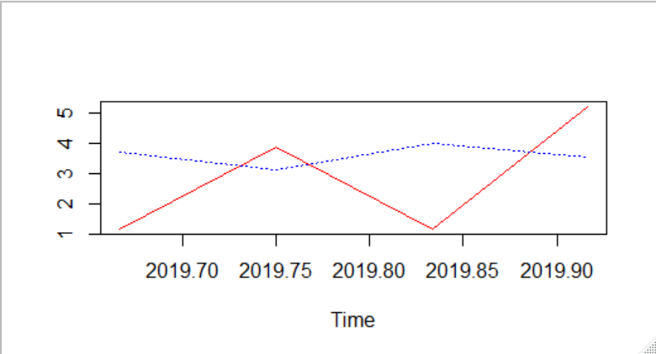
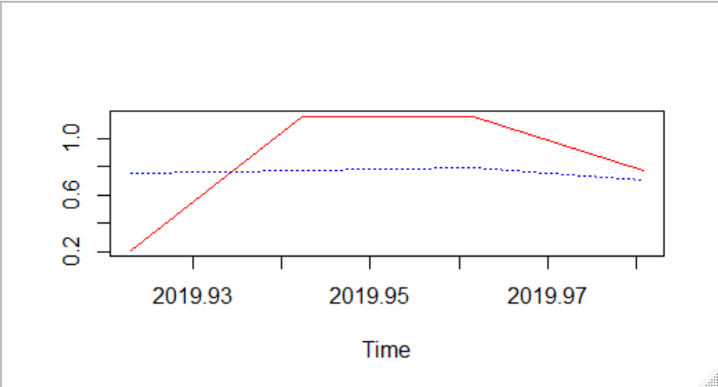
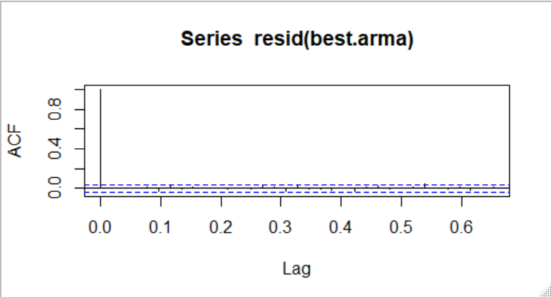
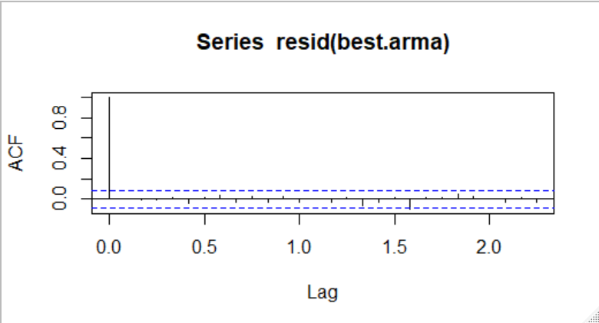
Arma: weekly and monthly
Best Weekly Model: 6, 5
Best Monthly Model: 5, 4
Weekly MAPE: 82.94
Monthly MAPE: 129.56

Slide 16
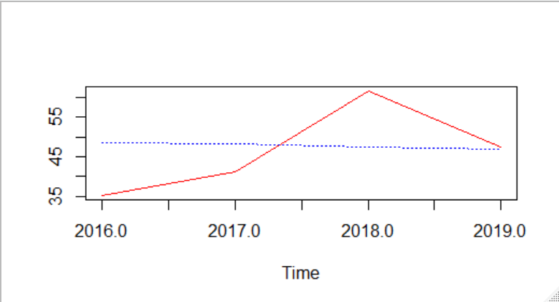
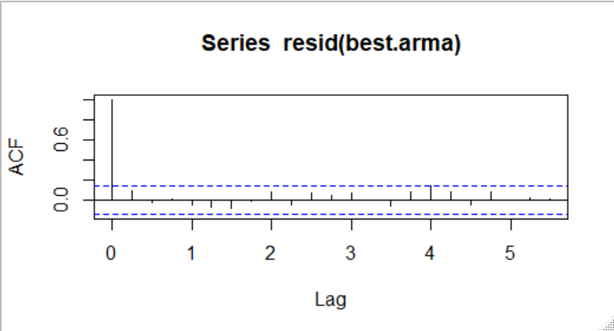
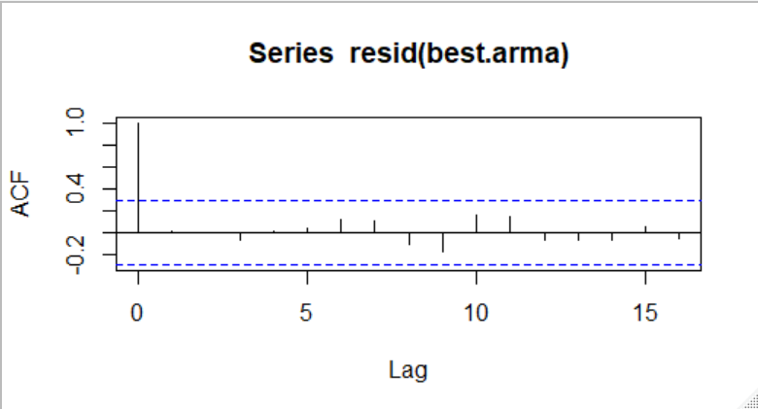
ARMA: seasonal and yearly
Best model for both: 0,0
Seasonal MAPE: 33.32
Yearly MAPE: 19.64

Slide 17
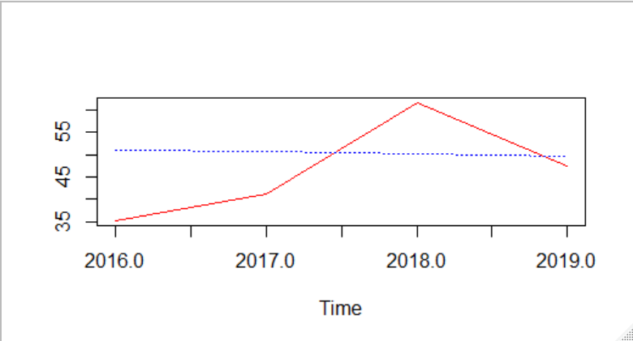
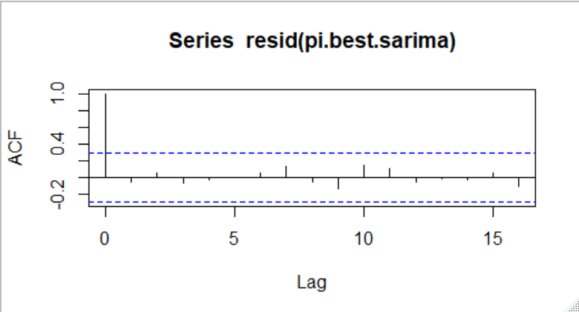
Sarima: yearly
Best Model : 0, 0, 2, 2, 1, 1
MAPE: 22.61

Slide 18
Conclusion
Table 1. MAPE Across Different Models
MAPE | HW | AR | LR | ARMA | SARIMA
Weekly | 105.2883 | 79.7363 | 82.8428 | 82.937 | X
Monthly | 152.414 | 113.6695 | 122.766 | 129.56 | X
Seasonal | 31.84925 | 33.31567 | 30.1668 | 33.3157 | X
Yearly | 17.598 | 16.38687 | 16.5433 | 19.64 | 22.61
Modeling precipitation is very difficult, most likely due to the day to day variation
AR was the best model for the weekly and monthly series
Linear regression was the best model for the seasonal and yearly series
The “true” best model is most likely one that was not tested and is beyond the scope of the course
Future research could focus on cities of similar climate to confirm the findings here or cities in different climates to see if different models are better

